Slide 1
Overview of the caloric test
Vicki Kennedy
Principal Clinical Scientist
Dept. of Medical Physics and Clinical Engineering
Royal Liverpool University Hospital
1
January 2019

Slide 2
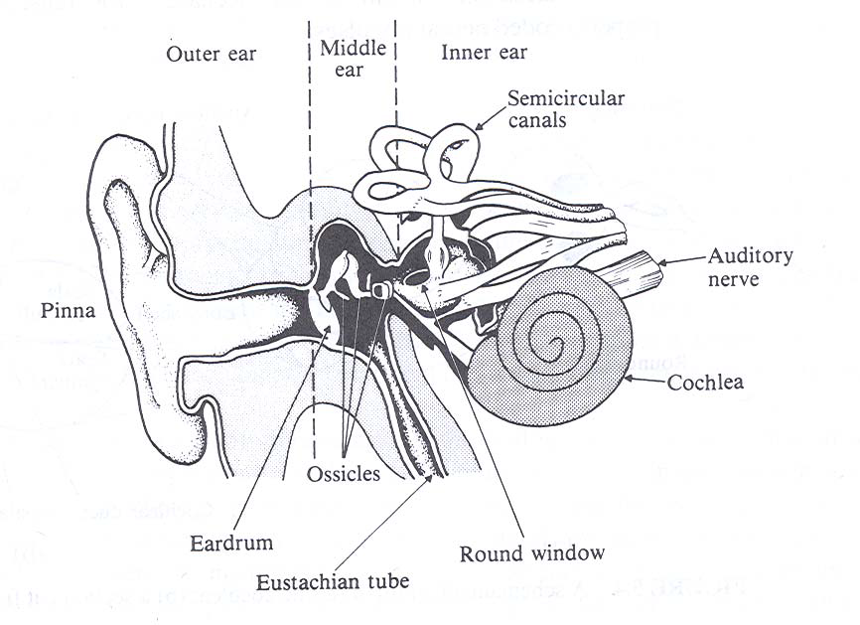
Anatomy of the Ear
3

Slide 3
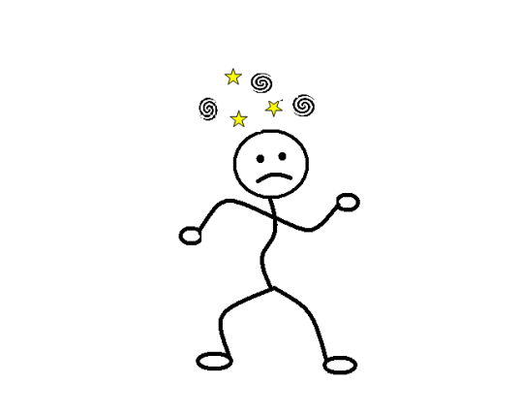
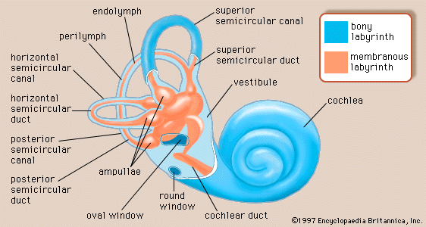
Vestibular end organ
22
Notes:
Balance organ (aka vestibular end organ, vestibular apparatus, vestibule, labyrinth)
3 semi-circular canals (horizontal, posterior, superior) detect head movement (angular acceleration) in 3 different planes.
The otoliths detect linear acceleration, gravity, tilt.

Slide 4
Vestibular-ocular reflex (VOR)
Balance organ in the inner ear detects head movement.
Brainstem reflex moves eyes in opposite direction to head movement to help maintain optic fixation.
When the eye meets the limit of gaze deviation it will rapidly be brought back to the centre of gaze. This rapid eye movement is called a saccade.
This repetitive eye movement is called nystagmus
We take nystagmus as evidence of vertigo.
23

Slide 5
Click the link below to see what nystagmus looks like…….
https://www.youtube.com/watch?v=oZLDonoByAE
24
Notes:
.

Slide 6
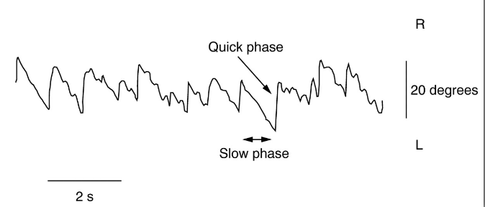
Nystagmus
Fast phase: a saccade
Slow phase: equal & opposite to assumed rotation
Slow phase velocity is taken as a surrogate for the extent of dizziness
Patient in darkness during testing so they cannot surpress nystagmus by fixating on surroundings.
25

Slide 7
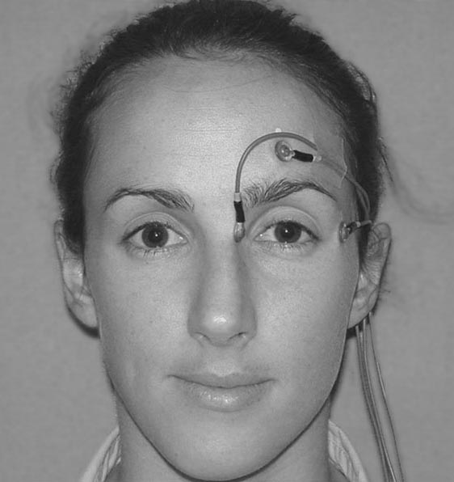
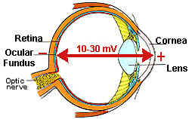
Measuring nystagmus: Electronystagmography (ENG)
Corneo-retinal potential is ~20 mV. Skin electrodes can pick up a fraction of this. The voltage is a function of eye position
Advantage: Tests possible with eyes closed
Disadvantage: Frequent re-calibration required due to changes in potential with changes in light levels.
26

Slide 8
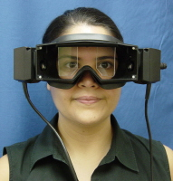
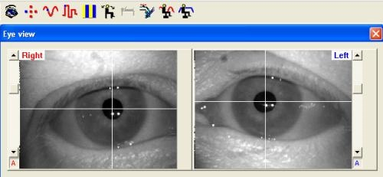
Measuring nystagmus: Videonystagmography (VNG)
Infra-red video camera monitor eyes (direct or reflected image
Image analysis software detects and tracks the pupil
Advantage: Stable calibration
Disadvantage:Tests not possible with the patient’s eyes closed
27

Slide 9
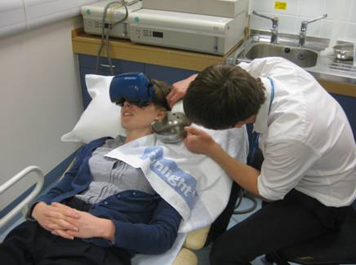
The Caloric Test
Measures semi-circular canal sensitivity.
28

Slide 10
Notes for calorics
A measurement of semi-circular canal sensitivity.
Each ear is stimulated individually using a warm or cool thermal (caloric) stimulus.
The thermal stimulus is in the form of water or air irrigated into the ear canal. A temperature gradient is established across lateral semi-circular canal. Convection currents are set up in the canal fluid causing it to circulate (see image on next slide). In essence, the warmed fluid becomes less dense and rises resulting in flow in one direction, whereas cooled fluid becomes more dense and sinks resulting in flow in the opposite direction to the warm.
This stimulation of the semi-circular canal results in nystagmus (vestibular ocular reflex VOR).
The slow phase velocity at the peak of the nystagmus is taken as an index of semi-circular canal sensitivity
An index of asymmetry (canal paresis) is calculated from the 4 irrigations (a warm and cool in each ear).
In general the less sensitive side is assumed to have the problem.
Vertigo and nystagmus induced by the irrigation lasts 1-2 minutes, although some people can feel unwell afterwards.

Slide 11
Links below to you tube clips of the caloric test (if the link does no work then cut and paste the link into your browser).
Simply Seth. The Caloric test
https://www.bing.com/videos/search?q=caloric+test+video&&view=detail&mid=A3C2237D85AA2048BF06A3C2237D85AA2048BF06&&FORM=VDRVRV
VNG – Hearing and Balance institute University of Utah
https://www.bing.com/videos/search?q=caloric+test+video&&view=detail&mid=D3E61C983B258D9E0605D3E61C983B258D9E0605&&FORM=VDRVRV

